Slide 1
Meggy Jr. RGB
By Christopher Barreto

Slide 2
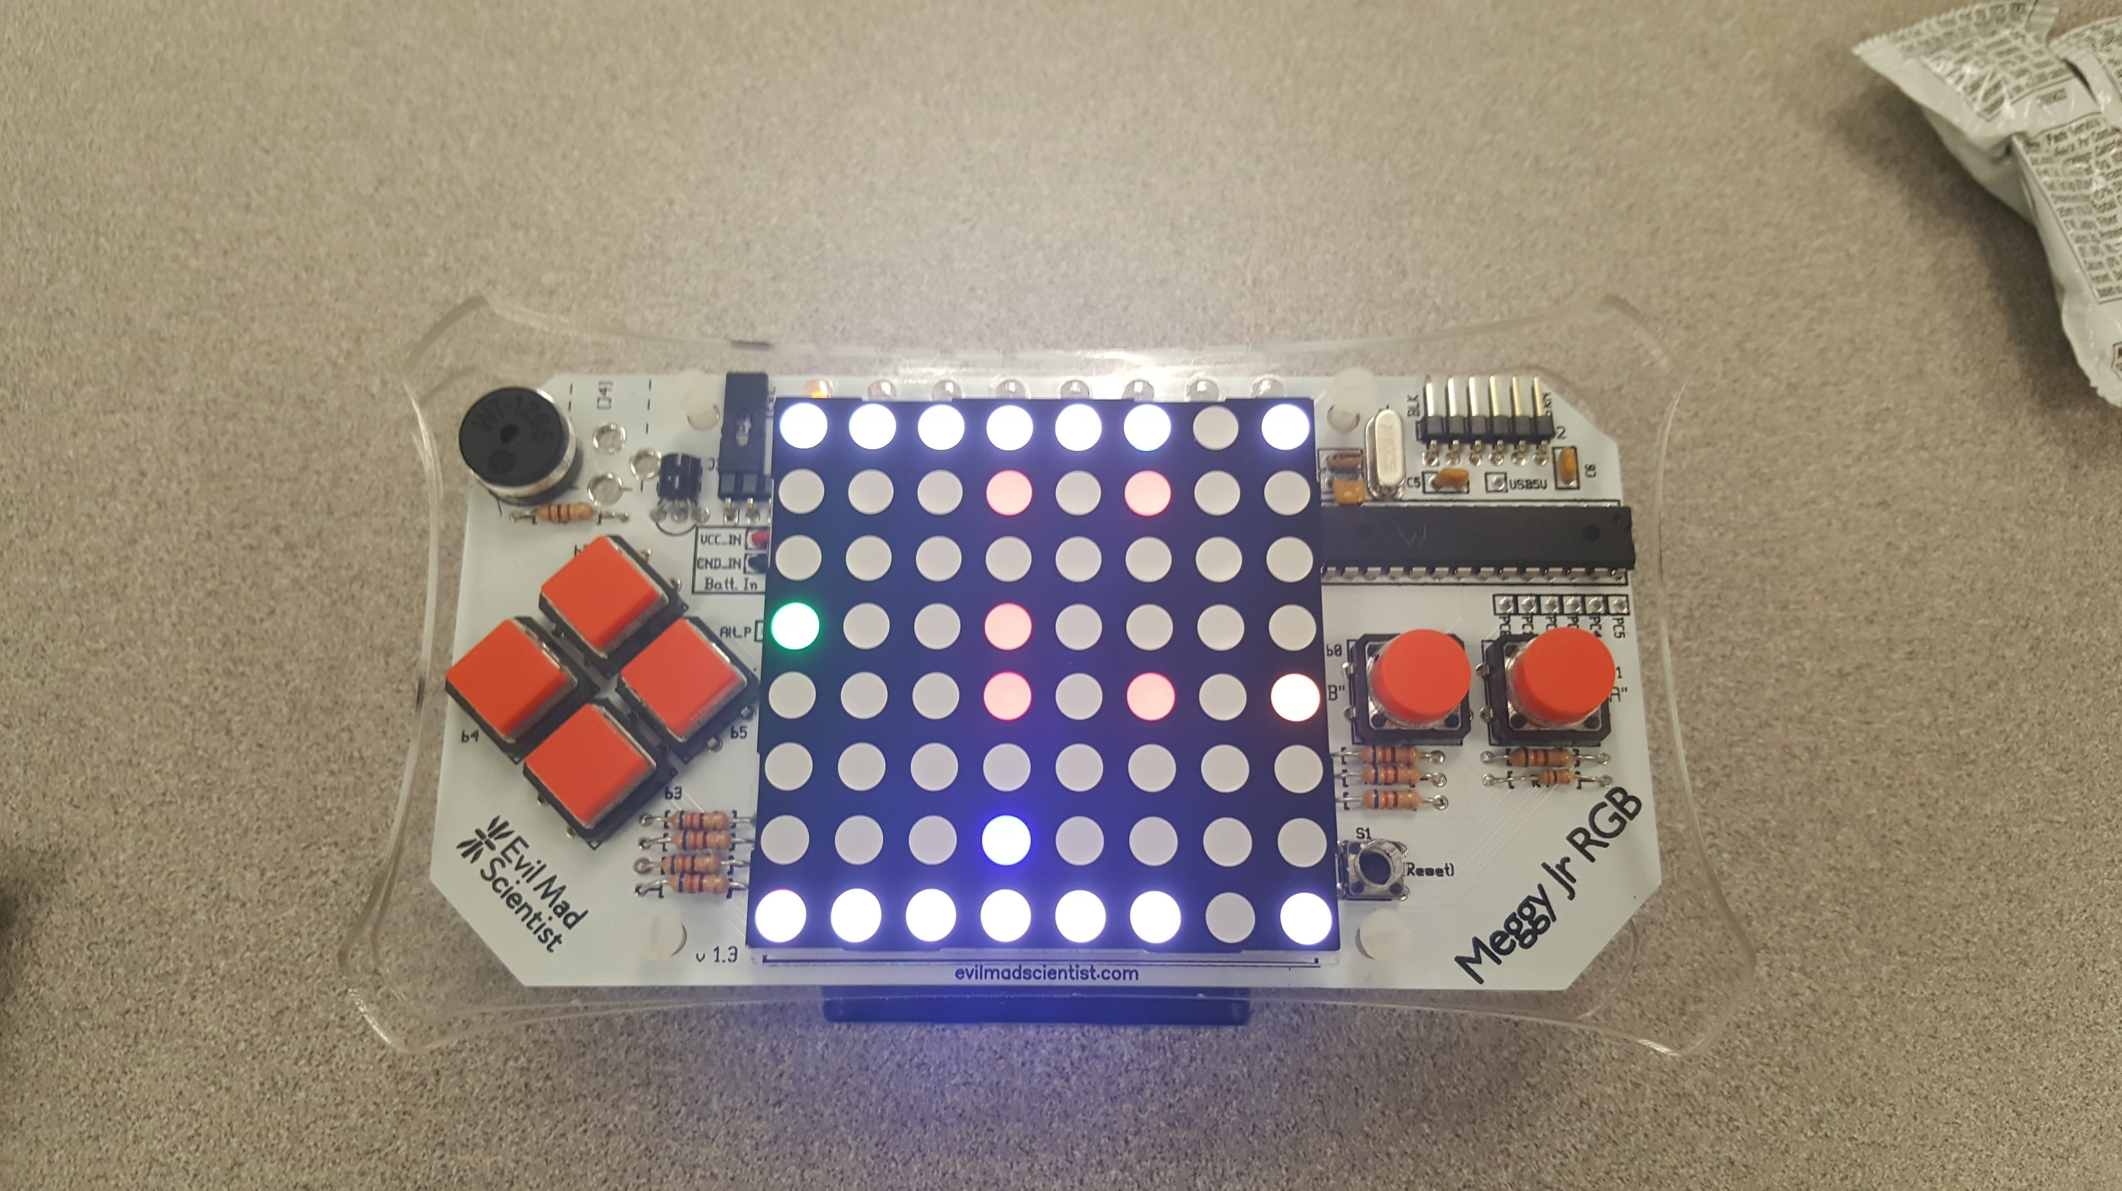
What is it?
The Meggy Jr RGB is a small portable gaming console that utilizes an 8x8 LED matrix RGB and circuit board to create a game and allow for control of the console.

Slide 3
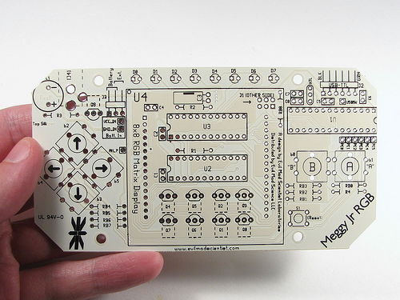
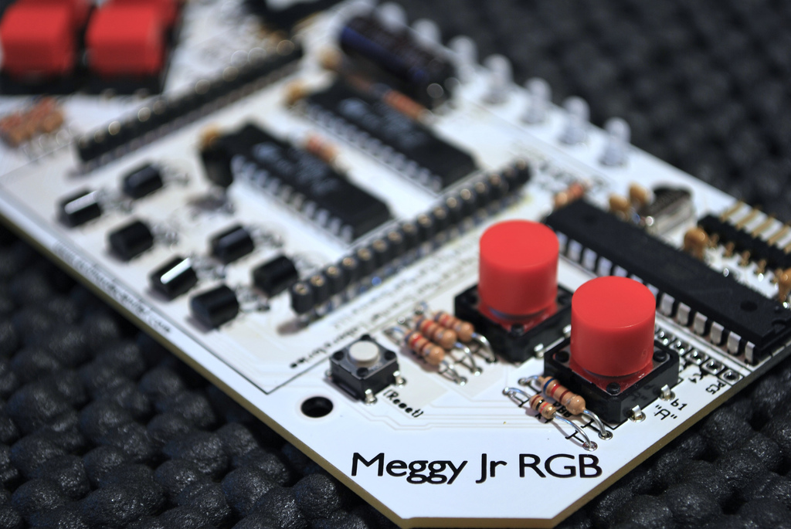
Creating Process
The main circuit board is the foundation of the console, it requires the use of multiple resistors, LED’s, and capacitors to allow the matrix to function. This board also offers the placement of several buttons specifically made for the system, they grant the user the ability to interact with the console, just like any other handheld gaming device.

Slide 4
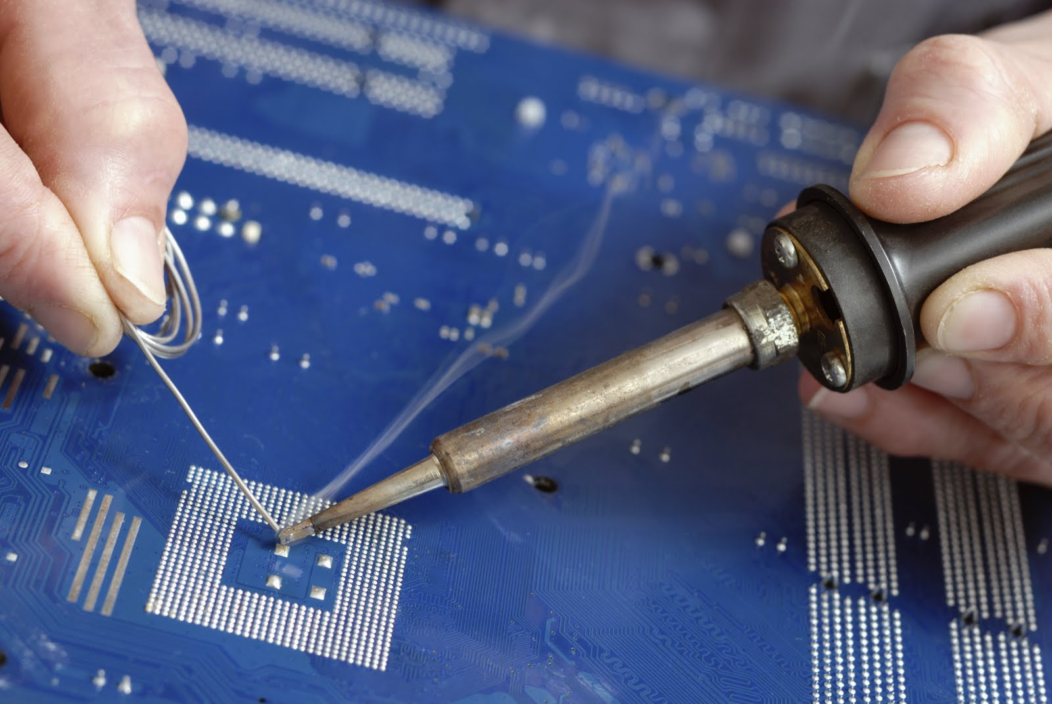
Difficulty
Soldering was the most difficult part of the process, mostly because of the strict caution of the heat and the problem with accidentally filling an empty socket in the circuit board. In fact, two different circuit boards were wasted because of this issue.

Slide 5
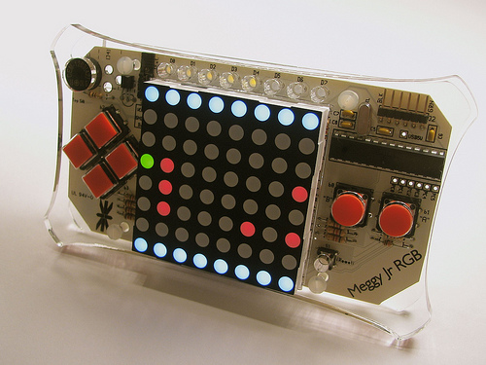

Game
The game that the system currently uses is similar to that of the classic retro game galaxia or any other type of arcade shooter. Another game was originally intended to be used but with lack of time and difficulty with Arduino, the original template game was used. In addition the sound does not work.

